Slide 1
TITLE: BOOK STORE USING MERN STACK
WEB APPLICATION

Slide 2
TEAM MEMBERS:
NIVASH. M(211521205101)
NITHYANANDHAN.K(211521205100)
RISHI.V(211521205120)
RAHIN MON(211521205116)

Slide 3
ABSTRACT:
A MERN stack-based book store is a full-stack web application designed to facilitate the buying and selling of books. Using MongoDB for the database, Express.js for the backend server, React.js for the frontend interface, and Node.js for server-side operations, the platform provides a seamless and efficient user experience. The store allows users to browse books by genre, author, and title, add books to their cart, and securely purchase them. Administrators can manage inventory, update listings, and track sales, ensuring a robust and scalable solution for book enthusiasts and sellers alike.

Slide 4
INTRODUCTION:
Our BookStore application, powered by the MERN stack, offers a seamless and interactive platform for users to explore, search, and purchase books online. The back-end, developed using MongoDB, ensures efficient data storage and management of books, authors, and user information. Express.js and Node.js form the robust server-side logic, providing secure API routes for browsing books, adding items to the cart, and managing orders. On the front-end, React.js delivers a dynamic, user-friendly interface, allowing visitors to browse collections, read reviews, and make purchases with ease. This full-stack solution ensures optimal performance and scalability, making it ideal for a modern online bookstore.

Slide 5
PROPOSED SYSTEM:
1. Frontend (React) User Interface: Home page displaying featured books, categories, and promotions. Search functionality to find books by title, author, category, or ISBN. Book details page displaying information such as the book’s description, author, price, and availability. User authentication (login, registration) for customers and admin.
Admin Interface: Dashboard for adding, updating, and deleting books. Managing book inventory (stock levels, prices). Handling customer orders (view, update status). User management (customer list, admin users).

Slide 6
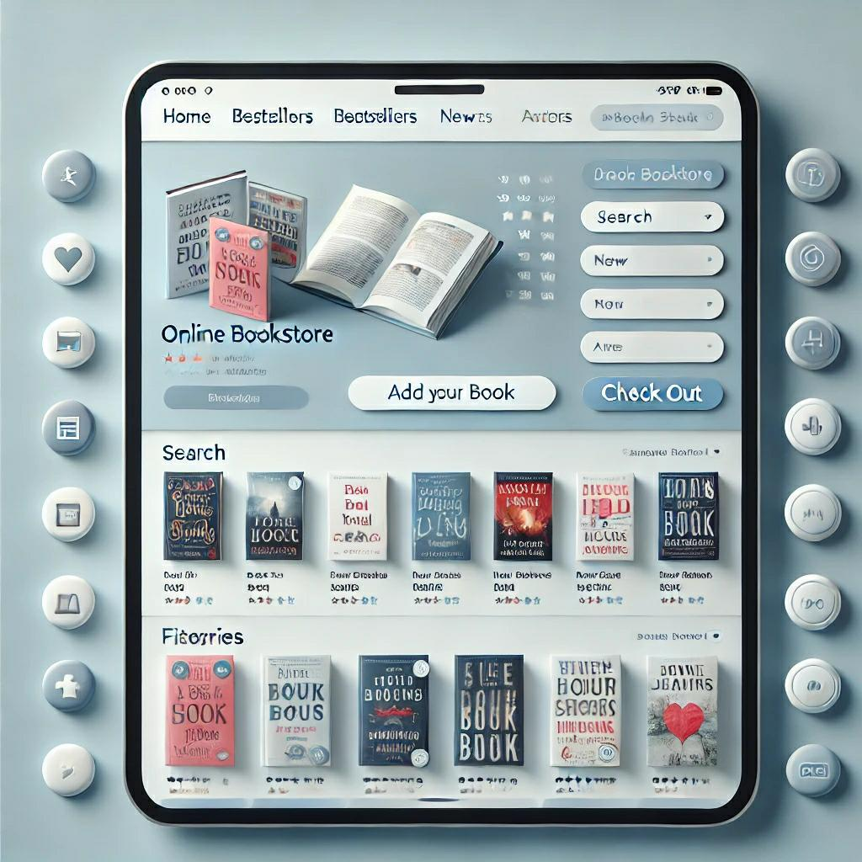
WEB APPLICATION:

Slide 7
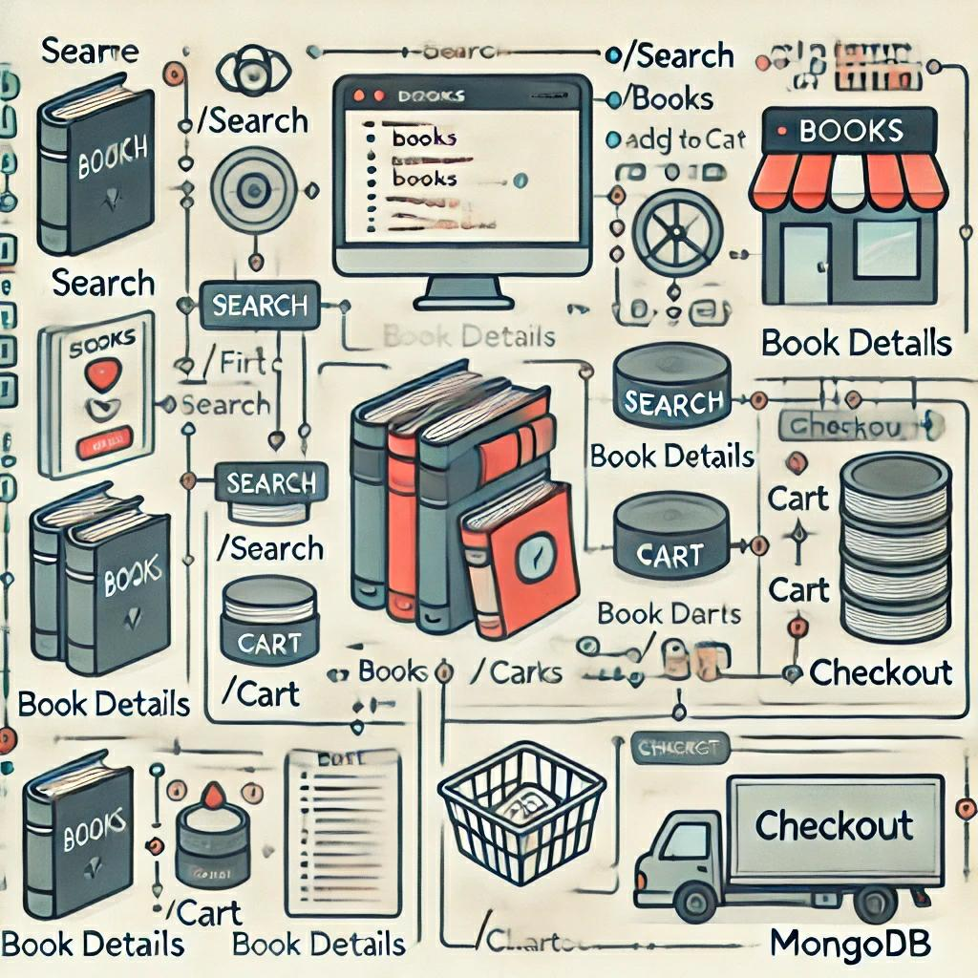
FLOWCHART:

Slide 8
CONCLUSION:
A bookstore application built using the MERN stack (MongoDB, Express.js, React, and Node.js) offers a robust, scalable, and efficient platform for managing book inventories, handling customer interactions, and processing orders. MongoDB allows for flexible data storage, enabling efficient management of books, authors, and customer data. Express.js and Node.js facilitate a smooth backend for handling requests, managing databases, and integrating payment gateways. React provides a dynamic and interactive frontend, ensuring a user-friendly interface for browsing and purchasing books. This full-stack solution ensures high performance, responsiveness, and scalability, making it ideal for a modern online bookstore.

Slide 9
THANK YOU

